Slide 1
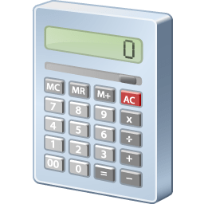
GUI-Based Calculatorin Python using Tkinter
A Step-by-Step Guide
VRINKA KALRA

Slide 2
Introduction to Tkinter
What is Tkinter?
Tkinter is the standard GUI library for Python.
It provides a fast and easy way to create GUI applications.
Why use Tkinter?
Simple and easy to learn.
Integrated with Python, no need for external installations.
Well-documented and widely used.

Slide 3
Project Overview
Objective:
To create a basic calculator with a graphical user interface.
Features of the Calculator:
Basic arithmetic operations (addition, subtraction, multiplication, division).
Clear button to reset the input.
User-friendly interface.

Slide 4
Setting Up the Environment
Required Software:
Python 3.x
Tkinter (usually included with Python)
Installation:
Ensure Python is installed: python --version
Import Tkinter:
import tkinter as tk

Slide 5
Designing the Calculator Layout:
Layout Components:
Display screen for input and results.
Buttons for digits (0-9) .
Buttons for operations operations (+, -, *, /, =,C).
Grid Layout:
Use Tkinter's grid system to organize buttons and display.

Slide 6
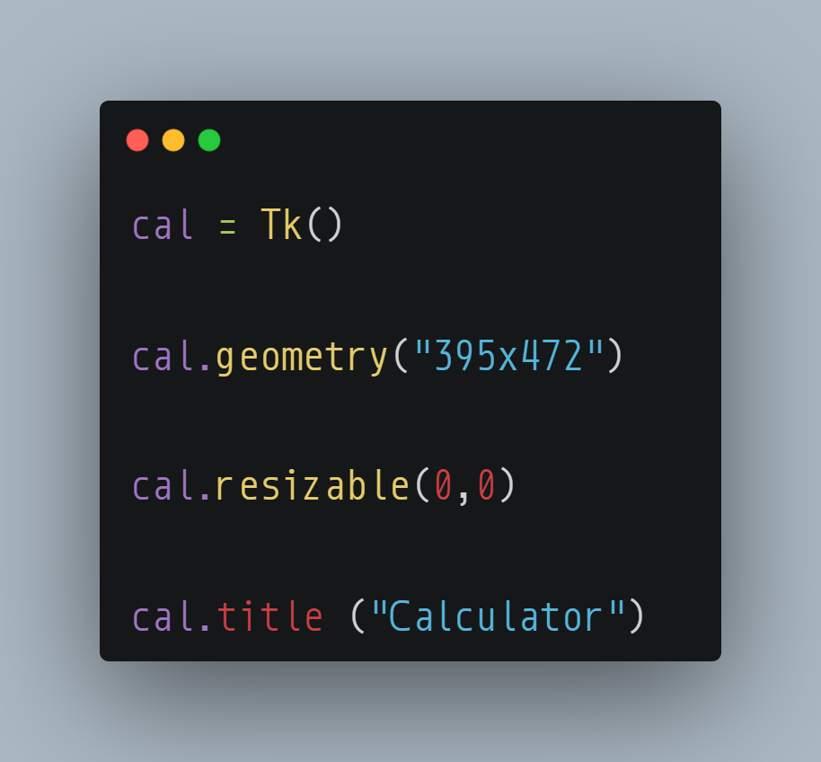
Creating the Main Window:
Code Snippet
Explanation:
Tk() initializes the main application window.
geometry() defines the window size.
resizable () defines that window can not be resized.
title() sets the window title.

Slide 7
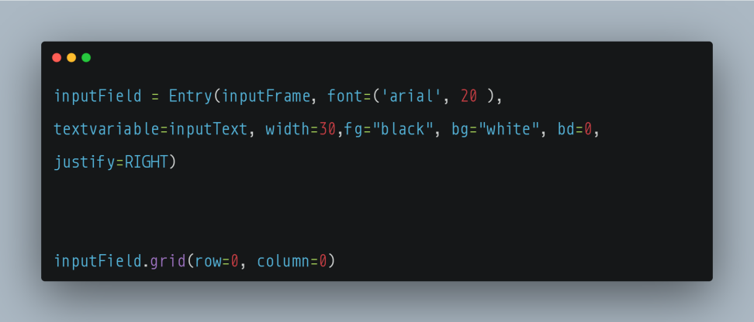
Adding the Display Screen:
Code Snippet:
Explanation:
Entry widget creates a single-line text box for the display.
grid() method places the widget in the window layout.

Slide 8
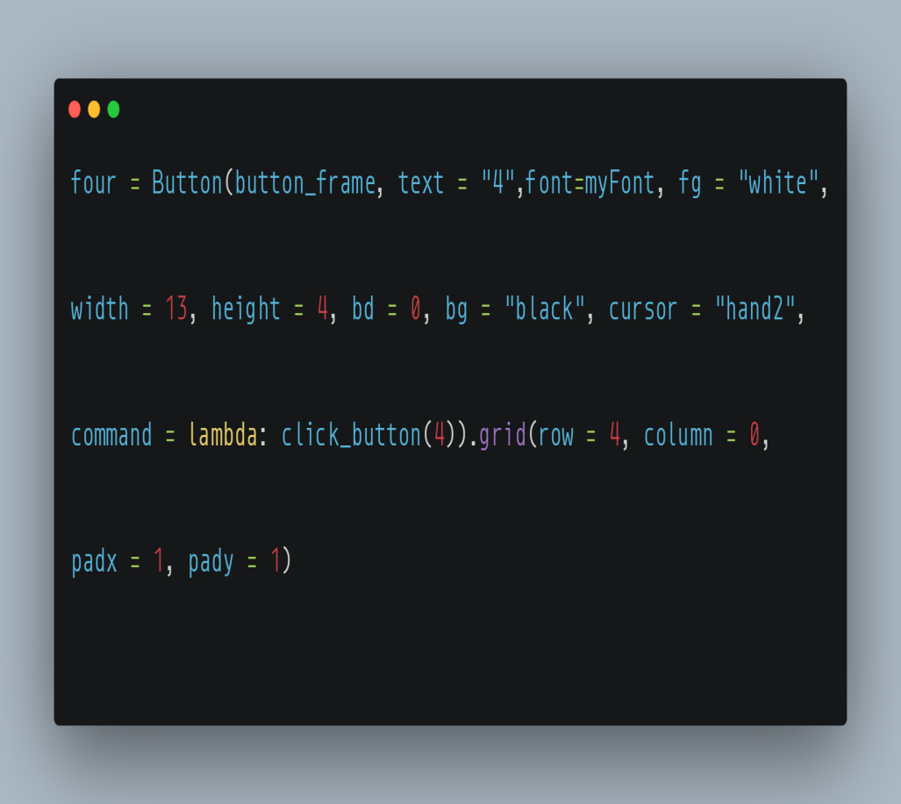
Creating Calculator Buttons:
Code Snippet:
Explanation:
Text Property: Text displayed on the button.
fg or foreground: Normal foreground (text) color.
bg or background: Normal background color.
grid(): grid method places the button in the window layout.
lambda: lambda is used to pass button value to the event handler.

Slide 9
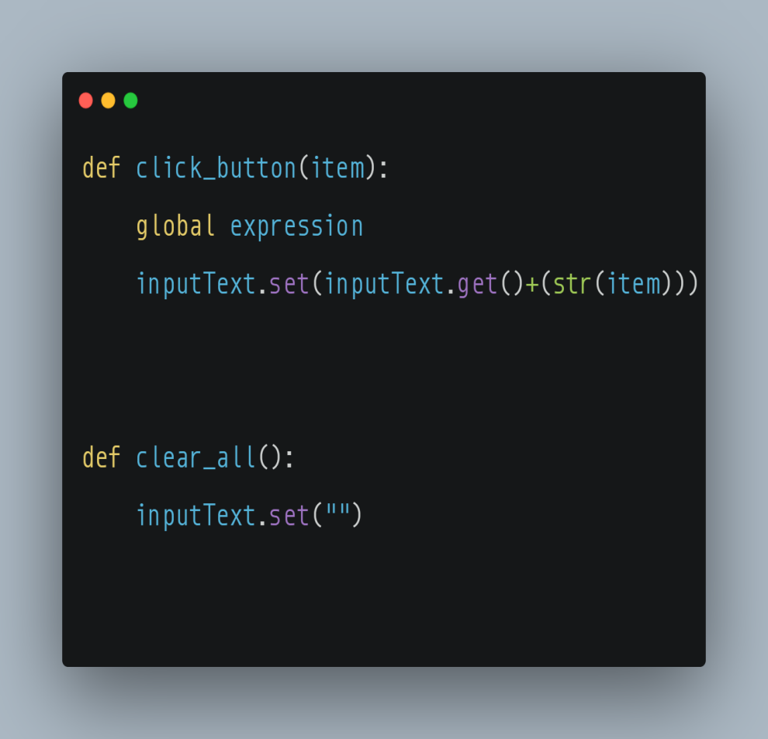
Handling Button Clicks:
Code Snippet:
Explanation:
click_ button: This function handles the button clicks.
clear_all : This function clears the input field.

Slide 10
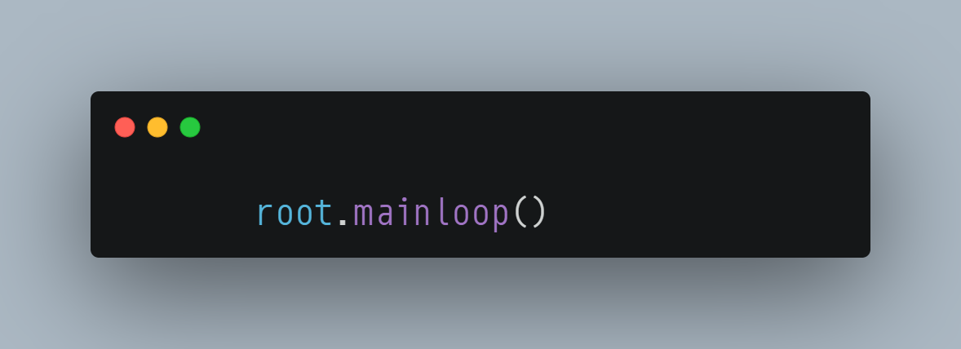
Running the Application
Code Snippet
Explanation:
mainloop() runs the application, waiting for user interaction.

Slide 11
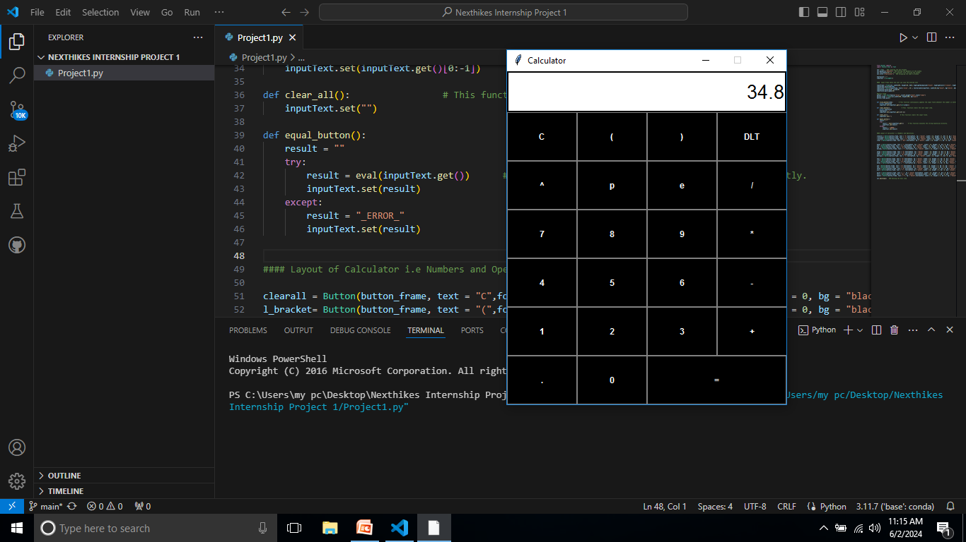
Demo :

Slide 12
Conclusion:
Summary:
Developed a basic GUI calculator using Tkinter.
Learned about Tkinter widgets and event handling.

Slide 13
Thank You…

